Slide 1
Exploring Science Night

Slide 2
Question & Answer Slides

Slide 3
Which Flies Further?
With or Without Tape?
Standard Paper or Construction Paper?
Loosely or tightly folded?

Slide 4
Why Does the Laser Follow the Water?
The laser is “trapped” inside the water because of Total Internal Reflection.
As the light tries to pass from the more-dense water to the less-dense air, it bends. (This is called refraction.)
At a certain point, the light bends so much that it bounces off the surface of the water.

Slide 5
Does the Water Temperature Matter?
No. Cold, room-temperature
and hot water all work the same.

Slide 6
Does the Type of Liquid Matter?
Yes. Some liquids are too dark or opaque and block the laser,
such as Milk & Cola.

Slide 7
Which Flies Further?
Catapult
Trebuchet

Slide 8
Which Is Easier to Aim?
Catapult
Trebuchet

Slide 9
How Do You Increase Distance for a Catapult?
A stronger rubber band
(or spring)

Slide 10
How Do You Increase Distance for a Trebuchet?
A heavier counter-weight (more coins)

Slide 11
Trebuchet Release Pegs:
Straight Peg – Flies at a higher angle, but less distance.
Angled Peg – Launches in a straighter trajectory (path). More distance, less height.

Slide 12
Will a CAN of Soda Create a Geyser (instead of a Bottle)?
Cans have a flat top with an opening on the side.
Bottles have cone-shaped tops which direct the soda to a center opening.

Slide 13
Does Regular Soda or Diet Soda Go Higher?
Diet. Aspartame (fake sugar) creates a stronger reaction than real sugar.

Slide 14
Is Sugar Required?
No! Seltzer Water created the highest geyser in our testing, probably because it has the most carbonation.

Slide 15
Why Do Mentos Create a Geyser (compared to other candies)?
Hundreds of tiny holes on the surface of the Mentos

Slide 16
Does the Soda Temperature Matter?
Yes. Cold soda reduces the reaction, which results in a shorter geyser.

Slide 17
Does the Type of Diet Soda Matter?
Yes. The amounts of both aspartame and carbonation impact the reaction.

Slide 18
Viking Ship: Goal
Float atop big waves in a storm instead of getting swamped by waves
(and sinking)

Slide 19
Viking Ship: Science
Warm air is lighter than cold air. It pushes down on the ship with less force (gravity). This lets the ship rise with the wave instead of tipping over.

Slide 20
Materials Needed

Slide 21
Paper Airplanes
Scotch tape
Child-safe scissors (optional)
Copies of paper airplane models
Copies of instructions for airplane models
Paper: white, construction, stock

Slide 22
Laser Waterfall
Bottles with holes drilled about ¼ from bottom (2-liter soda bottles work fine)
Corks to plug holes
Laser – 532nm 50mw Green Laser Dot Diode Module for Cutting 18x75mm 3v-5VDC with K9 Coated Glass Lens & AC Adapter & Heatsink, from Lilly Maria on Amazon.com ($40)
Liquids: water, milk, juice, lemonade, soda
Container to catch liquid waterfall
Containers/stands to hold laser and bottle above liquid-catching bottle
Extension cord (to plug in laser)

Slide 23
Mentos Geysers
Unopened sold bottles:
Cola, Diet Cola, Sprite, Seltzer water, Mtn Dew, other
Fred Meyer brand is cheap and works great
Mentos (available in bulk at Costco)
Low/wide container to place soda bottle in to catch soda
Tarps to catch what misses the container
Towels!
Container to dump soda in (or nearby sink)
Screw-on tube to hold that can easily dump Mentos into bottle (Optional. Available at toy stores.)

Slide 24
Viking Ship
Large “wine” corks, cut in half length-wise so there is a flat bottom and rounded top. Drill 3 holes into the rounded top.
Clear container for “ocean” filled with ½ inch of water and blue food coloring.
Clear plastic cup or vase to place on top of lit ship
Washers or other flat objects that slightly raise cup off container bottom
Matches
Lighter (safer & easier than matches since you don’t have to quickly throw away a match during the experiment)

Slide 25
Volunteer Instruction Slides

Slide 26
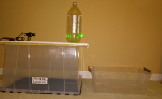
Laser Waterfall Instructions
Place cork in hole in front of bottle
Using funnel, pour water close to top of bottle
Plug in laser to turn it on (there is no on/off switch)
Line up laser thru corked hole
Pull cork out of bottle
After water stops, turn off laser
Pour water from container back into bottle

Slide 27
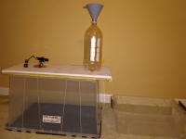
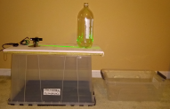
Laser Waterfall Instructions
Place cork in hole in front of bottle
Using funnel, pour water close to top of bottle
Plug in laser to turn it on (there is no on/off switch)
Line up laser thru corked hole
Pull cork out of bottle
After water stops, turn off laser
Pour water from container back into bottle

Slide 28
Mentos Geyser Instructions (without screw-on tube)
Put bottle in platter
Get 2-4 Mentos
Remove top from soda bottle
Quickly drop in Mentos
Dump soda into large container
(to dump down sink at the end)

Slide 29
Mentos Geyser Instructions (with screw-on tube)
Put bottle in platter
Close barrier in bottom of tube
Get 2-4 Mentos in tube
Remove top from soda bottle
Screw tube onto soda bottle
Remove barrier so Mentos drop into soda bottle
Dump soda into large container
(to dump down sink at the end)

Slide 30
Catapult Instructions
Make sure catapult is screwed onto board or clamped onto table
Place projectile (bean bag) into catapult
Aim catapult
Pull back arm of catapult
Release to launch!

Slide 31
Trebuchet Instructions
Place counter-weights (coins) in tray
Place release ring (non-attached end of rope holding sling pouch) into either Straight or Angled release peg at top
Holding trigger ring on bottom of sling pouch, pull sling pouch under axle until between two holes at front
Slide trigger dowel (stick with trigger cord) thru side holes and the trigger ring
Place projectile (ball) into sling
Aim trebuchet
Quickly pull trigger cord to fire!
To increase distance, use a heavier counter-weight.
Straight release peg – More angle, less distance
Angled release peg – Straighter trajectory, more distance.

Slide 32
Viking Ship Instructions
Fill container with ½ inch of water & food coloring
Place washers at bottom. (These are used to hold the cup slightly above the bottom of the container.)
Place 3 matches in holes of “ship”. The curved part of the cork faces up.
Light the matches
Quickly place ship in water between washers
Quickly place clear plastic cup on top of washers above ship
Water level within the cup will rise – raising the ship with it

Slide 33
Viking Ship: 3 Cups
Clear Plastic Cup – Placed on top of washers and lit ship during experiment
Blue Disposable Cup – Keep some water in here to ensure matches are fully extinguished
Blue Thick Plastic Cup – Safe temporary trash can for used matches

Slide 34


Ultrasonic Atomizer
Used in Humidifiers
Vibrates at the appropriate frequency to turn water into steam (instead of boiling)
Fogger or mist maker
Place in bowl of water. Plug in.
DO NOT TOUCH while operating. It will produce a stinging sensation.
Do NOT clean with chemicals

Slide 35
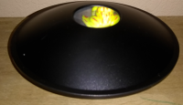
3-D Mirascope
2 parabolic mirrors that are facing each other
Top mirror has a hole in the center where the hologram effect takes place
By setting an object in the bottom parabolic mirror, it is projected as a solid object in the opening of the top mirror

Slide 36


3-D Mirascope
Parts:
base
frog
solid parabolic mirror
parabolic mirror with hole
Instructions:
Put base so solid side faces up
Place solid parabolic mirror on base, with mirror facing up
Place frog (or other object) in middle of solid parabolic mirror
Place parabolic mirror with hole upside down on top of solid mirror, with the mirror facing down (so it looks like a UFO)

Slide 37
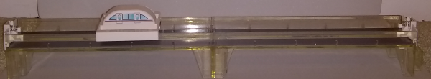
MagLev Train - Setup
Connect the 2 tracks together
Train floats on top of track
Move a separate magnet along track to move train

Slide 38
MagLev Train - Details
Short for Magnetic Levitation
Levitation – process by which an object hovers in the air
All magnets have 2 poles: north and south
Opposite poles attract and like poles repel (push away)
North + South attract
North + North repel
South + South repel
Strip magnets: north on one flat side and south on the other flat side
Magnets on track and under train are arranged so that like poles are faicing each other, and thus repel

Slide 39
MagLev Train - Facts
No friction between train and track
Little or no noise
Very efficient (saves energy)
Can be super fast
Most maglev railways use electromagnets instead of permanent magnets
Electromagnet – Made by sending electricity thru a coil of wire. Can be turned on & off by turning electricity on & off
Turning magnets on/off along the track moves the train

Slide 40
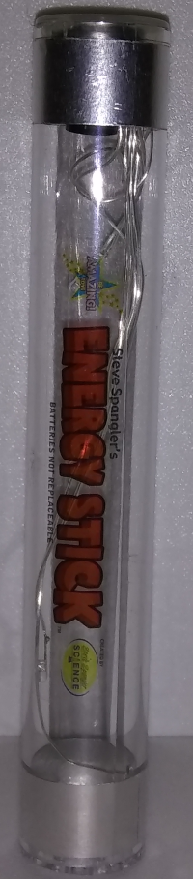
Energy Stick
Put one hand on each end of the Energy Stick
Energy Stick sends out an electrical signal that powers the flashing lights and buzzer when your body completes the circuit
Electricity travels safely on your skin
Multiple people can hold hands and complete the circuit

Slide 41
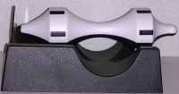
The Levitator
Place clear plastic shield vertically in end of base with “v” shaped end sticking up
Position spindle (barbell-shaped piece) on the stand with metal pointed end toward glass
Spin the spindle – the two opposing magnetic forces keep it rotating in mid-air

Slide 42
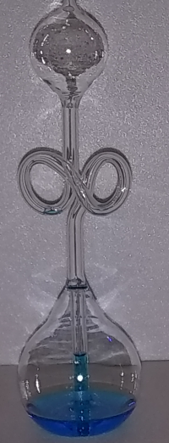
Hand Boiler - Info
Graps the larger bulb on bottom with your hand
Your body heat causes the liquid to rise and boil
Charles’s Law – A volume of gas at a constant pressure expands as the temperature increases

Slide 43
Hand Boiler - Explanation
Heat from your hand causes some of the liquid in the bottom bulb to heat up and evaporate into a gas.
As this gas expands, it causes the liquid to flow up to the top bulb, where it appears to bubble and boil.
When you release your hand, the gas condenses back into a liquid and flows down into the bottom bulb.

Slide 44
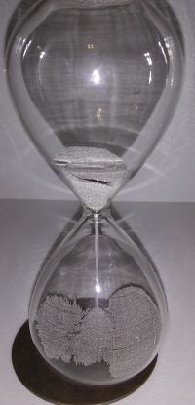
Magnetic Hourglass
Iron fillings in a glass timer react with a magnetic base
Produce gravity-defying artist displays
20-second timer

Slide 45
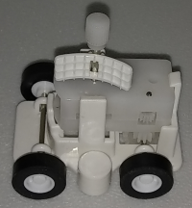
Zero Gravity Fridge Rover
Wind up rover and let it move along magnetic board, defying gravity
Combines a magnet and a wind-up vehicle
Gravity attracts objects toward each other, but magnetism can attract OR repel

Slide 46
Zero Gravity Fridge Rover
Coiled spring inside clockwork mechanism winds up tightly as you turn the crank, storing energy in the spring
When you let go, the spring uncoils, releasing the stored energy and turning the wheels
The magnet inside the rover holds it firmly against the fridge / magnetic board
Fridges are magnetic because they are made of steel

Slide 47
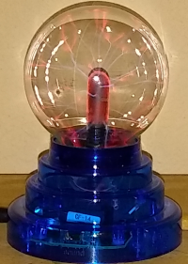
Plasma Ball
Contains a gaseous mixture
The base produces high frequency electro-magnetic waves that cause the gases to turn into plasma
Plasma = an ionized gas
The ions produced emit some energy in the visible region and appear as colored “streamers”

Slide 48
Plasma Ball
Responds to your touch
Plasma is attracted to your hand as it nears and touches the ball
You may feel a slight tingle sensation, which is caused by the vibrations on the glass ball as the electrons strike the surface of the ball

Slide 49
Plasma Ball - Usage
3 settings to switch:
Off
Audio – responds to music or voice
On

Slide 50
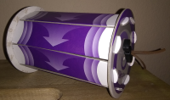
Boomerang Wheel
Push it away and it comes back!
Conserves energy by converting potential energy into motion
Law of Conservation of Energy says energy cannot be created or destroyed. It can only be transformed from one form of energy to another.

Slide 51
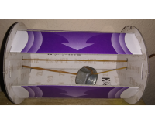
Boomerang Wheel – How it Works
Inside is a nut suspended by a rubber band that stretches across the wheel and loops thru holes in both ends of the wheel.
When you roll the wheel, the weight of the nut causes the rubber band to wind up.
When done rolling, the rubber band automatically unwinds, rolling the wheel backwards.

Slide 52
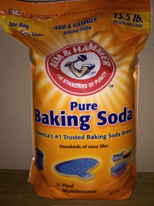
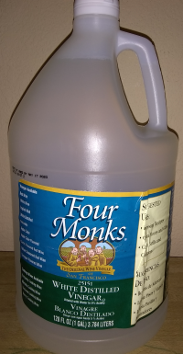
Volcano – Baking Soda & Vinegar
In test tube or cup, combine baking soda and vinegar
Results in immediate bubbling, which is gases created from reaction
If lid on test tube or in closed bag, bag will inflate from pressure created by gas
Reaction occurs because baking soda is a “base” and vinegar is an “acid.”

Slide 53
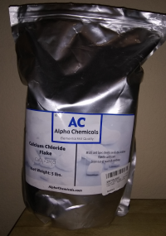
Hard Warmer: Calcium Chloride
In test tube, cup or plastic bag, combine calcium chloride flakes and water
Resulting chemical reaction geneates heat and bubbling of gases created from reaction
Use thermometer to show that temperature rises
Do experiment in closed bag to feel heat

Slide 54
Hard Warmer: Calcium Chloride
Hygroscopic – Absorbs water and then dissolves into it
Used in hand warmers and as “road salt” to melt ice
Similar to sodium chloride (table salt), but uses calcium instead of sodium. Extremely salty taste.
Also Used in Food:
Firming agent to help soft foods maintain their shape: canned fruits, vegetables and tofu
Electrolytes in sports drinks
Electrolytes are ions that conduct electrical activity and help your body maintain fluid balance as well as proper muscle and nerve functions

Slide 55
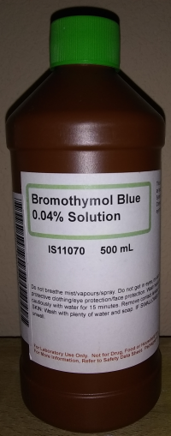
Bromothymol Blue (BTB)
Pour a small amount of BTB in cup
Blow into cup via straw for 1-2 minutes
Liquid turns yellow from the carbon dioxide from your breath
Put on lid and shake, open lid to let in air, close lid and shake again. Solution is back to blue/green.
Experiment can be repeated.

Slide 56
Bromothymol Blue (BTB)
Bromothymol Sulfone Phthalein
pH sensitive dye used in many laboratory reactions
A weak acid used as an indicator to determine pH (level of acidity)
Yellow – acidic
Blue – base
Green – neutral

Slide 57
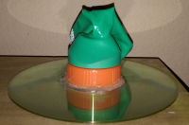
Hovercraft - Build
Take CD, DVD or even a record
Attach sports bottle cap over hole using a hot glue gun
Place balloon on top of bottle cap
Glue balloon if necessary, but should work without gluing

Slide 58
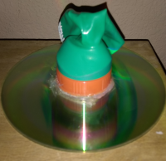
Hovercraft - Operate
From bottom of hovercraft, inflate balloon by either blowing into it or using a pump
Quickly place on table
As air rushes down out of balloon, the CD hovers and floats on top of the table
Cushion of air enables frictionless movement

Slide 59
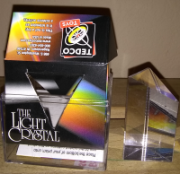
Prism – Refraction
Refraction = Bending of light
As white light travels from the air to the prism, the light slows down as it enters the prism.
If it enters the prism as an angle, this slowing makes it change direction as well as speed.
Rainbow = Raindrops act like a prism

Slide 60
Prism – Wavelength
Bending is determined by wavelength and angle the light hits the surface of the prism.
Each color has a slightly different wavelength, so the colors are bent at different angles.
Red = Longer wavelength. Bends less.
Blue = Shorter wavelength. Bends more.

Slide 61
Prism – Operate
Place prism in bag
Shine light thru prism
Thin rainbow will appear in back of bag
LED and fluorescent lights do not work since they are not “white” light, like sunlight

